Slide 1



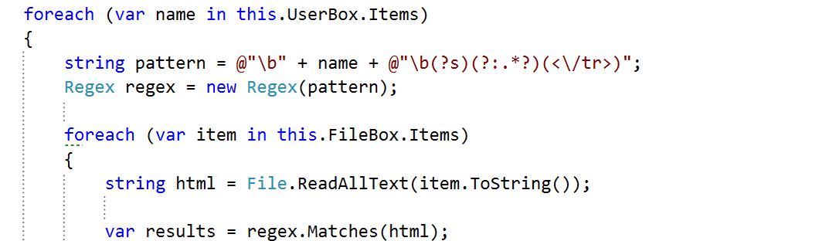
C# OOP Basics
Course Introduction
OOP Basics
SoftUni Team
Technical Trainers
Software University
http://softuni.bg

Slide 2


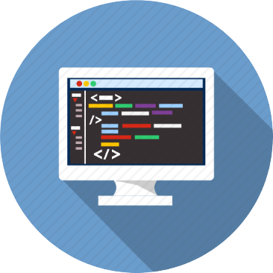
Table of Contents
Course Objectives
Course Program
Trainers Team
Course Schedule
Exams and Evaluation
Learning Resources

Slide 3







SoftUni Diamond Partners

Slide 4
Questions
sli.do #CSharp-Fund

Slide 5
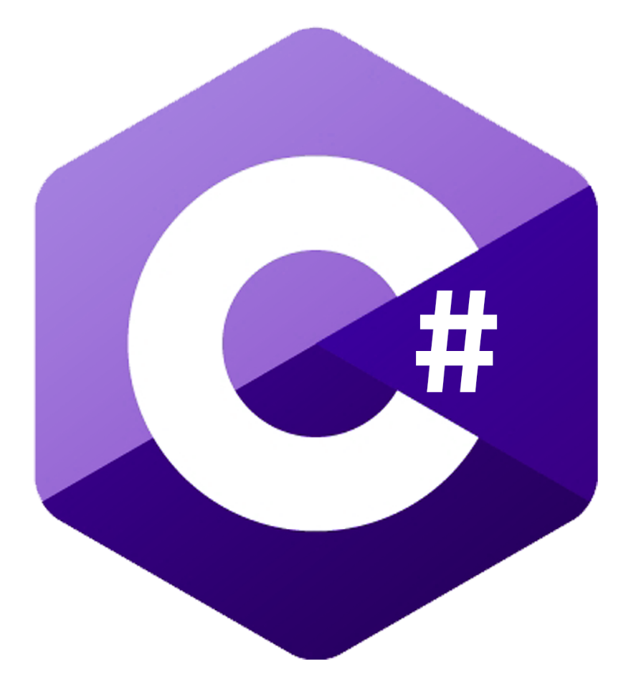
C# Fundamentals Module @ SoftUni
Database Fundamentals
Intensive 4 Months C# Training

Slide 6
C# Fundamentals Module Goals
4 months intensive C# training
4 times weekly, lots of live coding and homework
Part I – C# Advanced
Stacks & Queues, Matrices, Streams, Functional Programming
Part II – C# OOP Basics
Defining Classes, Encapsulation, Interfaces, Polymorphism
Part III – C# OOP Advanced
SOLID Principles, Generics, Iterators, Reflection, Unit Testing

Slide 7

C# Fundamentals Module – Timeline
22-Jan-2018
12-Feb-2018
19-Mar-2018
24-Apr-2018
C# Advanced
Lessons + exercises + exam
3 weeks * 4 times / week
6 credits
Start: 22-Jan-2018
Final exam: 11-Feb-2018
OOP Basics
Lessons + exercises + exam
5 weeks * 4 times / week
9 credits
Start: 12-Feb-2018
Final exam: 18-Mar-2018
OOP Advanced
Lessons + exercises + exam
5 weeks * 4 times / week
12 credits
Start: 19-Mar-2018
Final exam: 22-Apr-2018
Re-Take Exams
C# Advanced: 24 Apr 09:00
OOP Basics: 26-Apr 09:00
OOP Advanced:
28-Apr 09:00

Slide 8
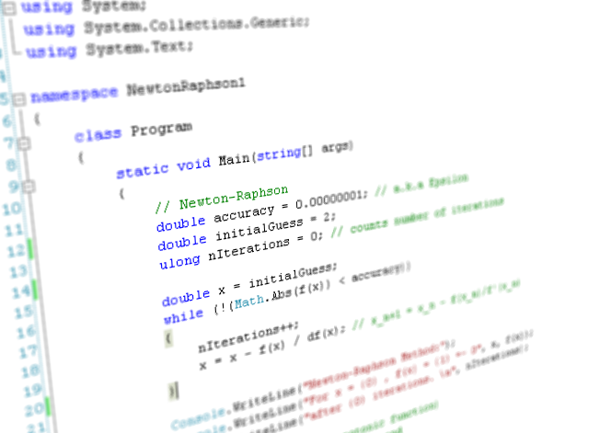
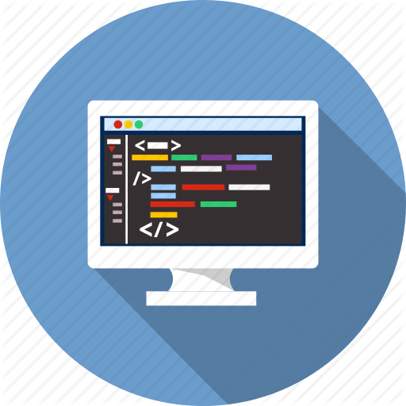
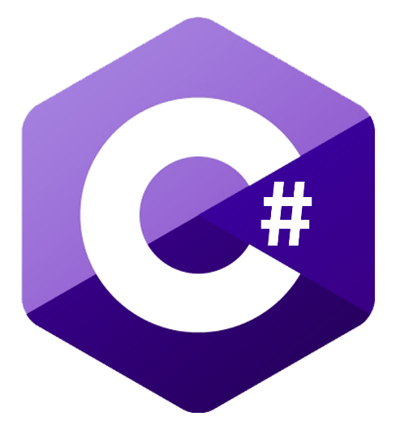
C# OOP Basics
Course Objectives & Program

Slide 9

Course Topics
Defining Classes
Working with Abstraction
Encapsulation
Inheritance
Interfaces and Abstraction
Polymorphism
3 Workshops
3 Exam Preparations

Slide 10
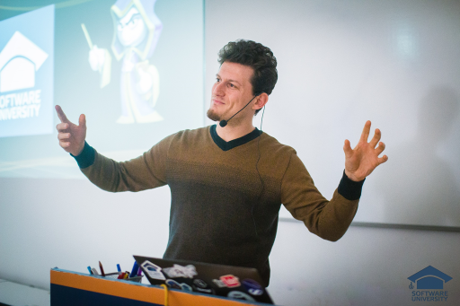
The Trainers Team

Slide 11
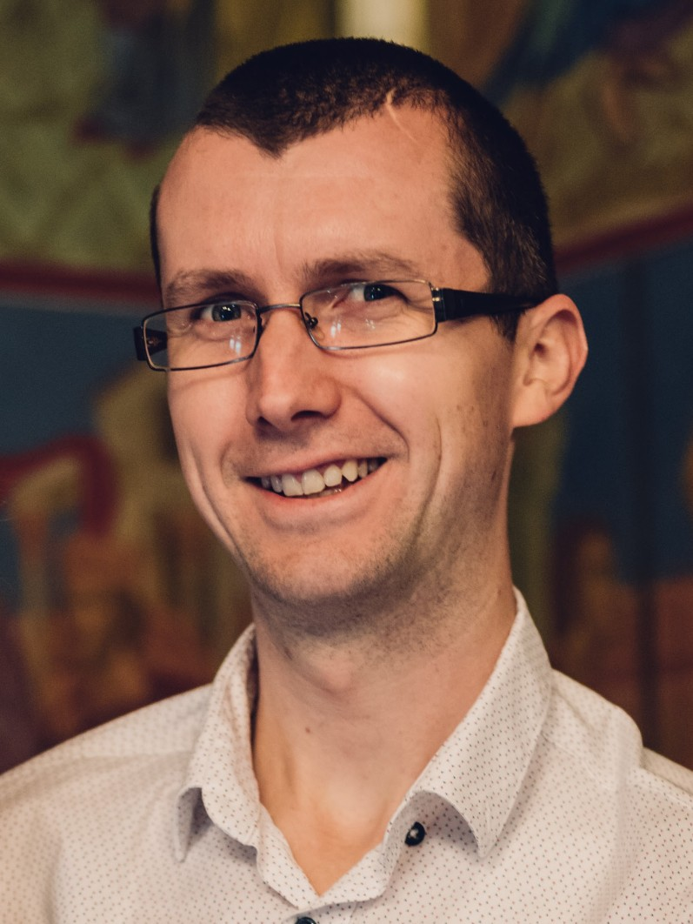
Trainers Team
Yavor Valchev
Senior Programmer with 10 years of experience
Team Lead at Up2 Technology
Interested in mountain hiking, traveling and meeting new people

Slide 12
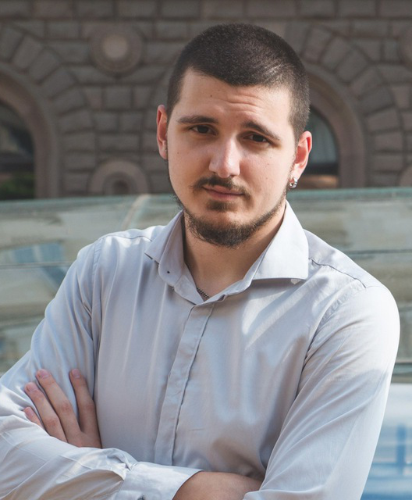
Trainers Team (2)
Bozhidar Danchev
Technical Trainer @ Software University
Top performing student from the Software University
Interested in smart technologies, AI and Gaming

Slide 13
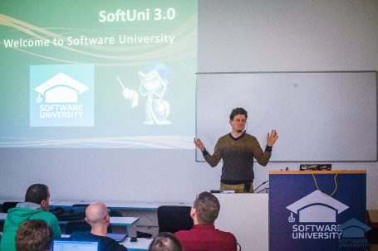


C# OOP Basics
Course Details and Schedule

Slide 14
Why OOP?
Object-oriented programming is an important paradigm
Anyone involved in software development should be familiar with OOP and OO modeling
All modern languages are either object-oriented or support classes and objects
Modern frameworks, libraries and APIs are object-oriented
E.g. .NET Class Library (C#), Java API classes (Java), Android, Laravel (PHP), Django (Python), Rails (Ruby), STL (C++), …
OOP is a basic requirement for starting a job as developer

Slide 15
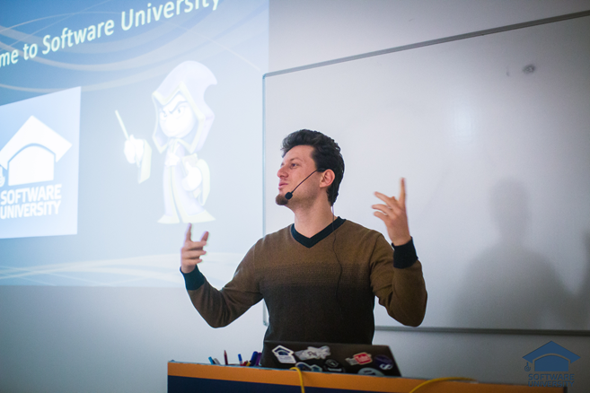
Training Duration and Schedule
Lessons: ~ 50 hours (onsite + YouTube videos)
Practical exercises (in class): ~ 30 hours
Homework: ~ 0-60 hours
Exam preparation: ~20 hours
Time frame
12-Feb-2018 – 18-Mar-2018

Slide 16

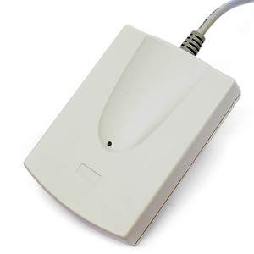
Your RFID Chip
Students can either
Take RFID chip from SoftUni
Or use their own chip / card (125 KHz)
Register your chip number in your SoftUni profile: https://softuni.bg/users/profile/show
Check-in at the reception every time when you come in SoftUni
See your last visits in your profile: https://softuni.bg/users/profile/show

Slide 17


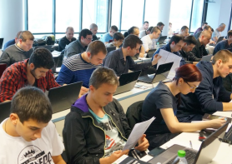
C# OOP Basics
Evaluation Criteria

Slide 18


Scoring System for the Course
Mandatory:
Final exam – 85%
Exercises & homework – 15%
Bonuses:
Presence in class – 5% bonus
Forum activity – bonus up to 5%
BashSoft – 5% bonus

Slide 19
The OOP Exam
1 practical problem for 6 hours:
You need to create the project object domain
You should implement functionality
Your project should be written in C#
Should correctly follow the OOP principles
Automated judge system with real-time feedback
Upload a zip project to the judge system

Slide 20


Homework Assignments & Exercises
Your homework is mainly work in class!
Lesson days → slides + live demos + exercises
Exercise days → only exercises
How to submit your homework?
Submitted in the judge system
Do your homework when it's due!
Assignments pile up quickly

Slide 21









Resources
What We Need Additionally?

Slide 22



Course Web Site, Forum and FB Group
Official web site:
Official discussion forum:
Official Facebook group:
https://softuni.bg/courses/csharp-oop-basics/
softuni.bg/forum/categories/30/
facebook.com/groups/ SoftUniCsharpFundamentalsJanuary2018

Slide 23
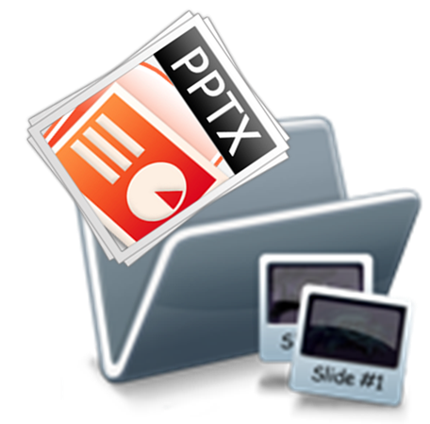


The C# OOP Basics Slides and Videos
All lecture slides, videos, exercises, projects and other resources are open content, available for free
Visit the course web site to access the course resources

Slide 24

The Free C# Fundamentals Textbook
The official textbook for the course
"Fundamentals of Computer Programming with C#", by Svetlin Nakov & Co., 2013, ISBN 9789544007737
English and Bulgarian versions (as PDF, ePub, …)
Freely downloadable from: www.introprogramming.info
The C# Programming courses @ SoftUni.bg partially follows the book

Slide 25
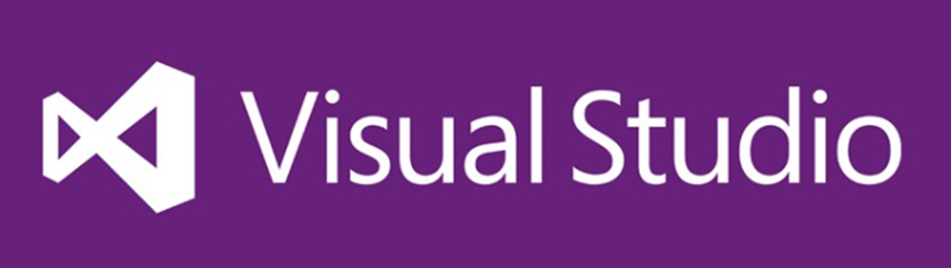

Required Software
Software needed for this course:
Microsoft Windows (Win 10 / 8.1 / Win8 / Win7)
Visual Studio Community 2017 (a free version of VS 2017)
.NET Core 2.1 (included in Visual Studio)

Slide 26
C# OOP Basics – Course Intro
https://softuni.bg/courses/csharp-oop-basics

Slide 27

License
This course (slides, examples, demos, videos, homework, etc.) is licensed under the "Creative Commons Attribution-NonCommercial-ShareAlike 4.0 International" license
Attribution: this work may contain portions from
"Fundamentals of Computer Programming with C#" book by Svetlin Nakov & Co. under CC-BY-SA license

Slide 28

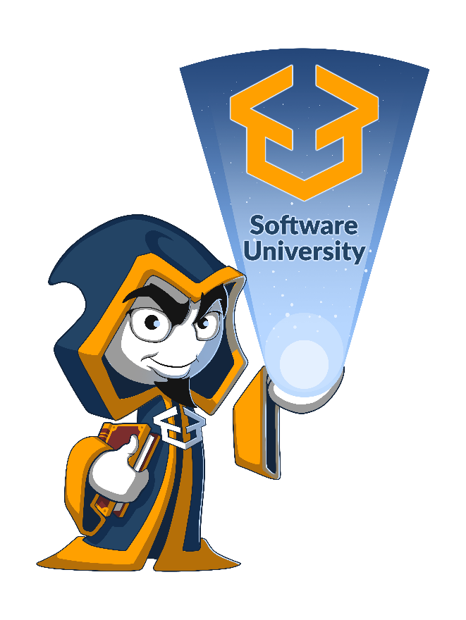



Trainings @ Software University (SoftUni)
Software University – High-Quality Education, Profession and Job for Software Developers
softuni.bg
Software University Foundation
http://softuni.foundation/
Software University @ Facebook
facebook.com/SoftwareUniversity
Software University Forums
forum.softuni.bg

